Slide 1



Biddhanir: AI-Powered Learning in Bangla
A Revolutionary Educational Platform for Bangladesh

Slide 2




Team Members
Sunzil Khandakar
Md Mehedi Hasan
221-15-5383
221-15-5976
Md. Umar Faruk
Md. Mahmudul Hasan Anik
221-15-4920
221-15-4983

Slide 3

Vision & Mission
Vision
Quality education accessible to all in Bangladesh
Mission
Use AI to give each person learning that fits them, keeps them
interested, and matches their culture.

Slide 4
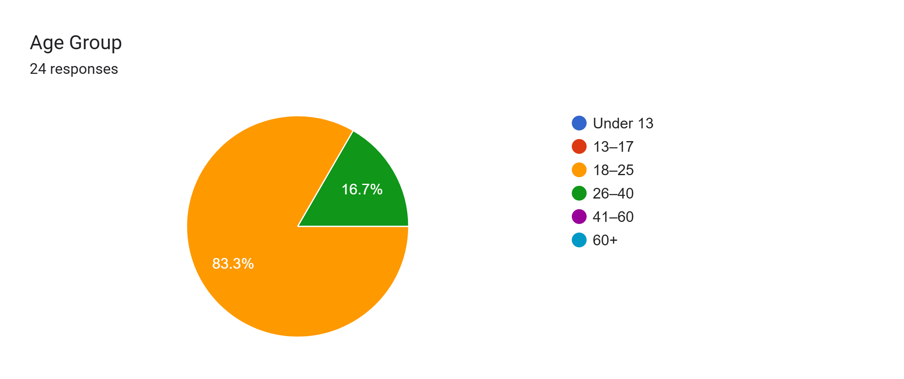
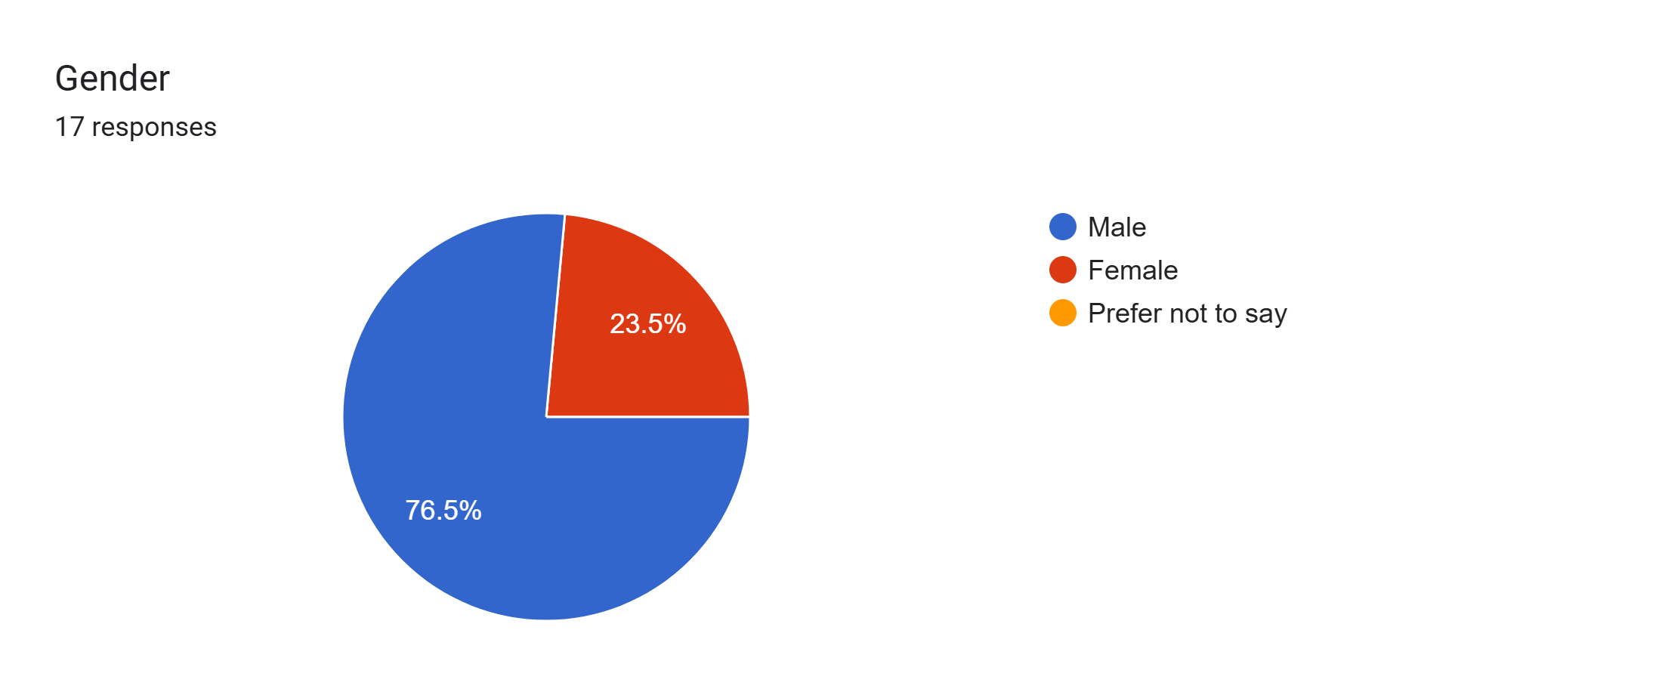
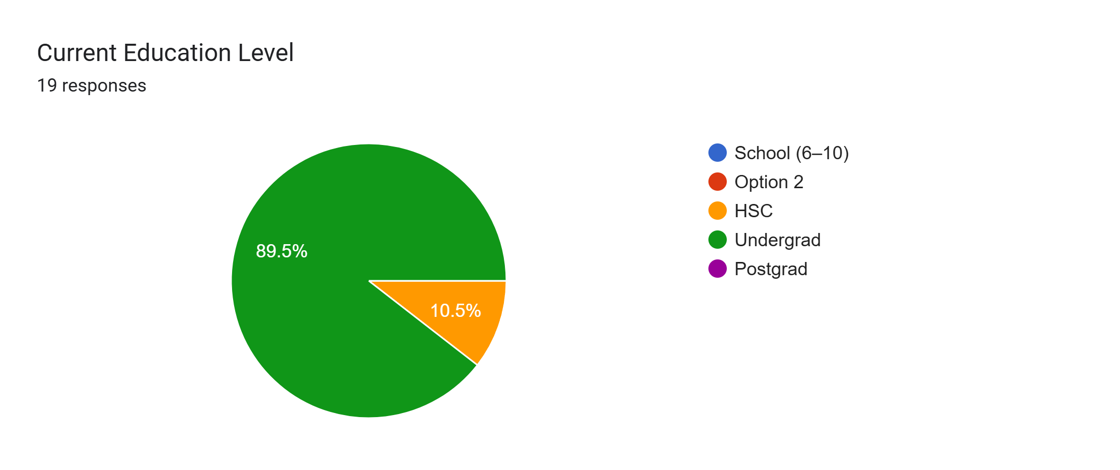
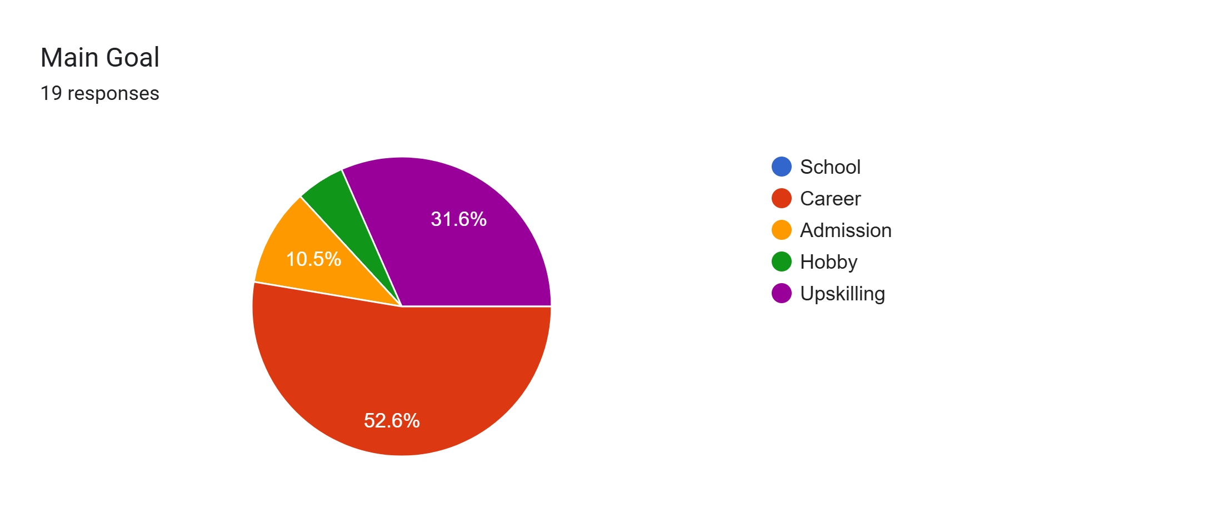
Identifying the User
Age group
Gender
Current Education Level
Main Goal

Slide 5
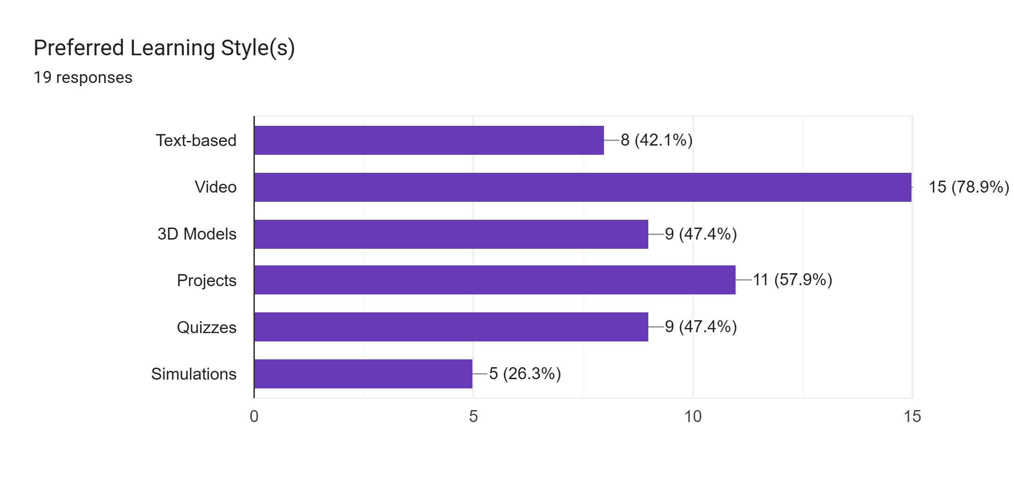
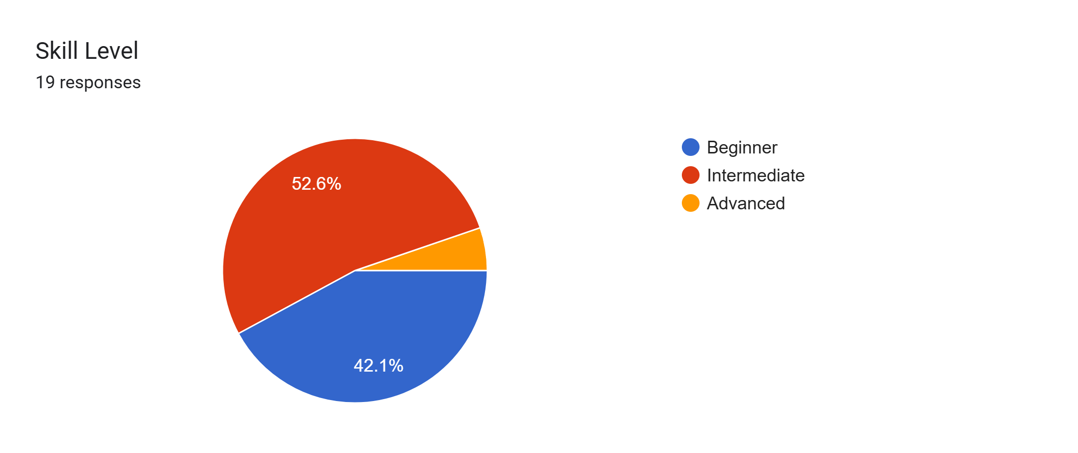
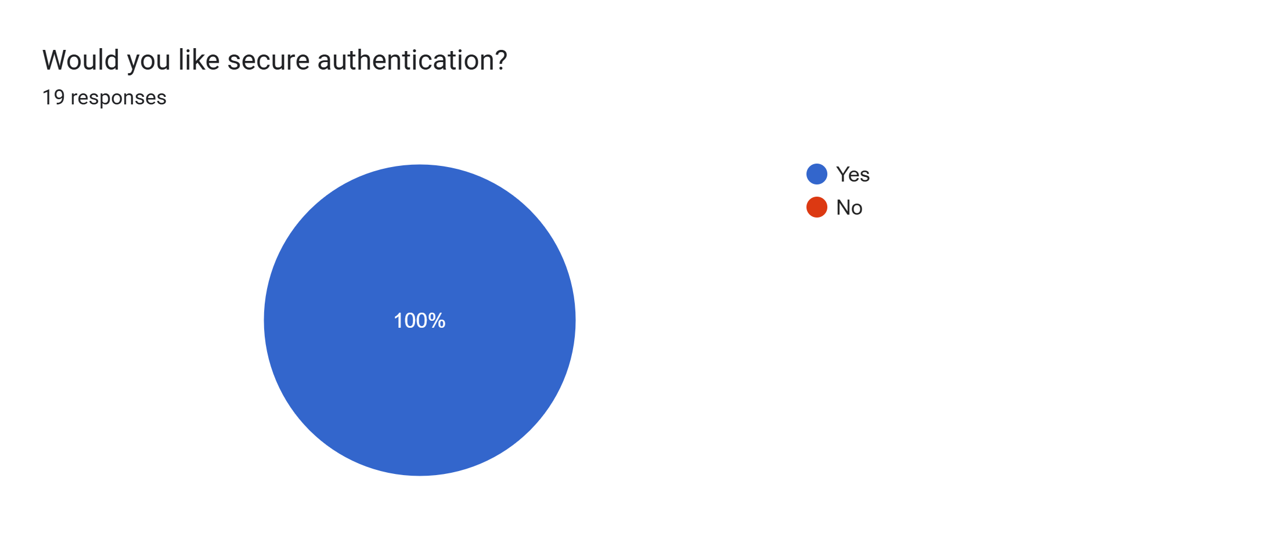
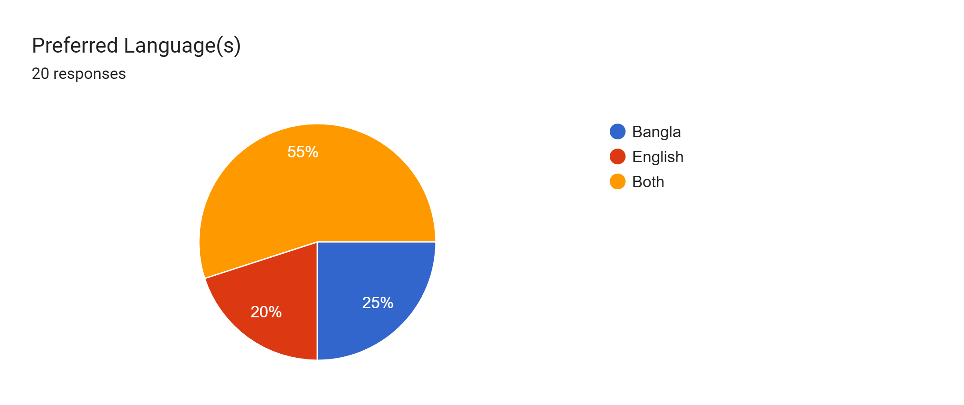

User Preferences
Preferred Learning Style(s)
Skill Level
Authentication?
Preferred Language
Want personalized course

Slide 6

The Problem
Fragmented, overcrowded educational content
Lack of personalization in learning platforms
English-only content limits understanding
Limited hands-on, visual learning tools

Slide 7
The Solution – Biddhanir
AI-Powered
Interactive Content
Bangla Support
Responsive Design
Personalized courses tailored to learners
3D models and curated videos
Full Bangla content generation
Accessible on all devices daily

Slide 8

Key Features
AI-Generated Courses
Tailored to user goals
3D Simulations
Biology, space, technology
Multimedia Content
Bangla and English support
Custom Learning Paths
Progress tracking included

Slide 9
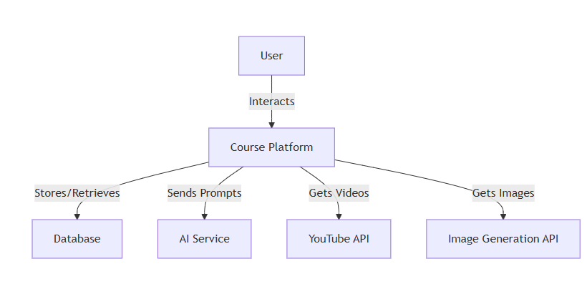
DFD 0

Slide 10

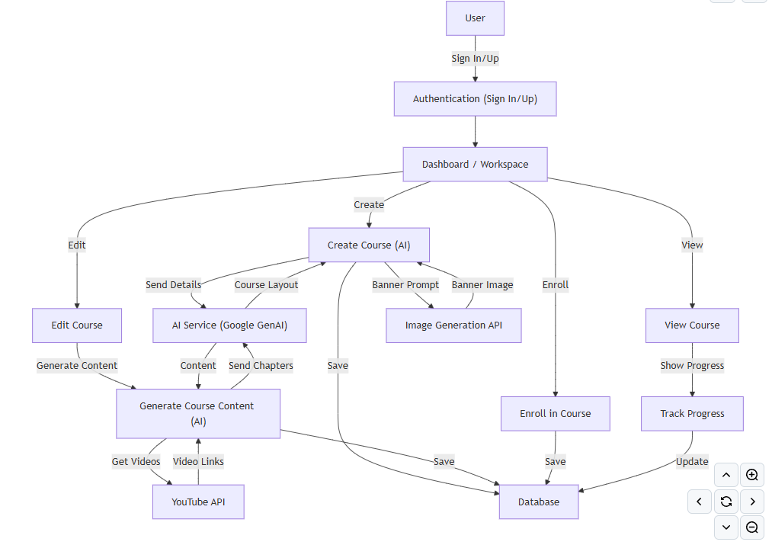
Use Case Diagram

Slide 11
Technology Stack
Frontend
Backend
AI
Services
Next.js
PostgreSQL (NeonDB)
Google Gemini
Clerk (auth)
Tailwind CSS
Drizzle ORM
OpenRouter
YouTube API
Radix UI
Next.js APIs
Ai Guru Lab API

Slide 12

Impact in Bangladesh
Democratizes Education
Native language support
Bridges Urban-Rural Divide
Equal access to learning
Empowers Learners
Students, professionals, lifelong learners
Encourages Daily Learning
Supports career advancement

Slide 13
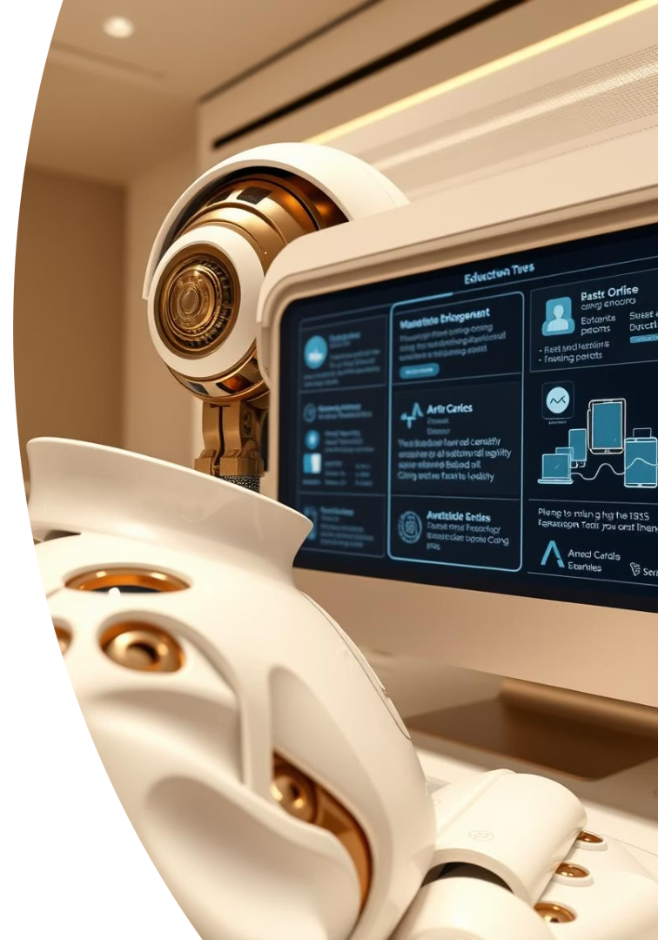



Course Generation System
Step 1
AI creates course structure
Step 2
AI generates detailed HTML content
Step 3
YouTube and 3D content integrated

Slide 14
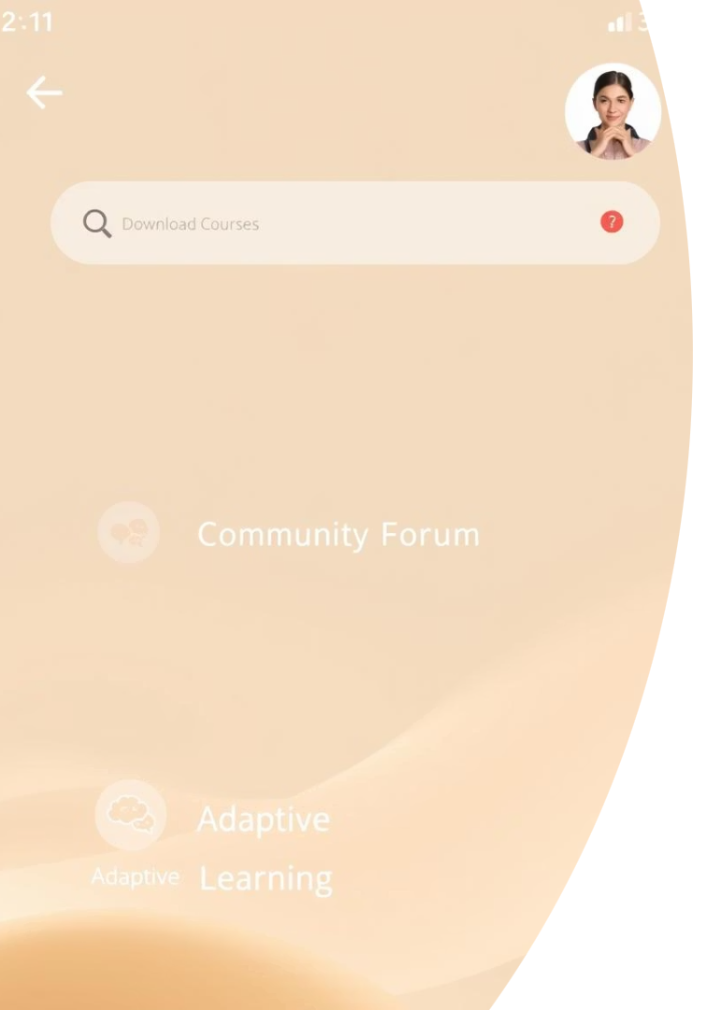
Future Scope
Mobile App
Offline learning support
Adaptive AI Paths
Personalized learning journeys
Curriculum Integration
National certification support
Community Learning
Bangla discussion forums

Slide 15

Why Biddhanir Matters
First of Its Kind
Inclusive Education
Building Skills
AI learning platform in Bangla
Accessible to all learners
Smarter generation for Bangladesh

Slide 16
Thank You
We appreciate your time and attention.

